Slide 1
Reading
Chapter 7

Slide 2
Writing System
Grapheme – unit of written language that corresponds to a phoneme

Slide 3
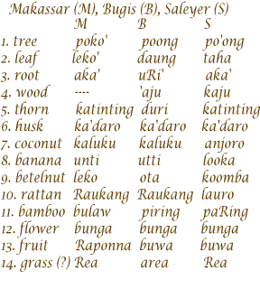
Writing System
All spoken languages distinguish between vowels and consonants
No common relationship between written languages

Slide 4
Writing System
Alphabetic scripts – English and European languages
Basic unit of representation is grapheme = phoneme
Some are one to one
English is many to many
abcdefghijklmnopqrstuvwxyz

Slide 5
Writing System
Consonantal scripts – Hebrew and Arabic
Not all sounds are represented, vowels are not written at all
Syllabic scripts – Japanese kana, Cherokee
Written units represent syllables
Logographic/ideographic scripts – Chinese Japanese kanji
Each symbol is a morpheme

Slide 6
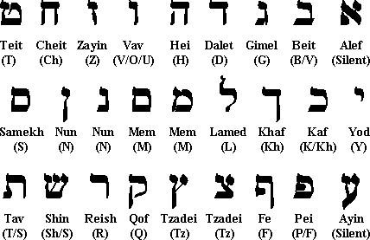
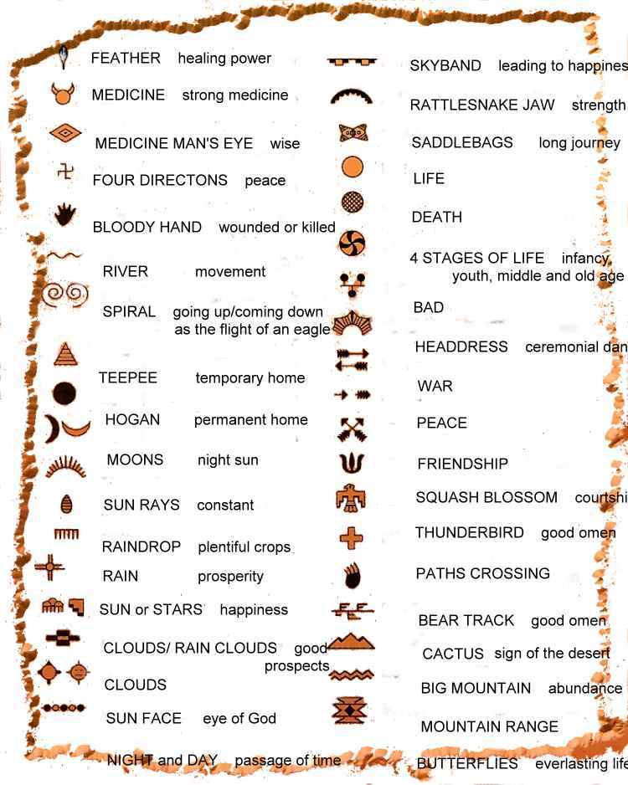
Writing System

Slide 7
Writing System
One issue with all these different writing systems is that processing must be different for different languages (most research here is in alphabetic scripts)

Slide 8

Models of Reading
Think about how you might pronounce the words that are you seeing
How would you do it?

Slide 9
Models of Reading
Spelling to sound correspondence – for regular words where the grapheme matches the phoneme, and you don’t need anything special to sound them out.

Slide 10
Models of Reading
Regular words – graphemes have the standard pronunciation
Irregular words – do not match sound to spelling rules (vase, have)

Slide 11
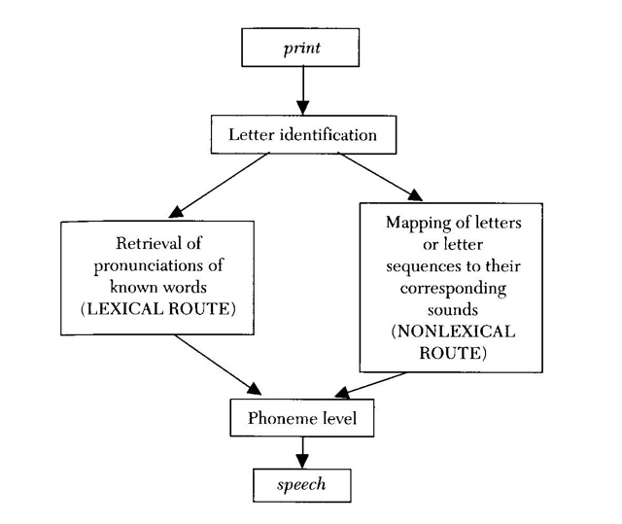
Dual Route Model

Slide 12
Models of Reading
Lexical route or direct access – used for irregular words with special pronunciations
Grapheme to phoneme conversion (GPC) route – also tends to be called the indirect or nonlexical or sublexical route

Slide 13
Models of Reading
GPC route
Used for reading nonwords and regular words
Phonological recoding (sounding it out)
Does not use the lexicon at all
Hooked on Phonics!

Slide 14
Models of Reading
Dual Route Model
Most people see reading as a race between the two routes, tend to be slow when we have to rely on lexical route – especially for new or weird words

Slide 15
Model Testing
NWs, word processing, orthography, phonological mediation
We try to see if there are interactions between the two sides…or are they totally separate.

Slide 16
Normal Reading
Reading nonwords – reading NW goes through the GPC route which implies that they are all alike

Slide 17
Normal Reading
Pseudo homophone effect – NWs that sound like a word when pronounced (brane, nite)
Faster to name them but slower to reject them as NWs
Visual similarity causes this effect
So is it GPC or orthography?

Slide 18
Normal Reading
Glushkos Exp – lexical effects on NW reading
Words with regular neighbors – taze (gaze, laze, maze), feal (real, seal, deal)
Words with irregular neighbors tave (have), fead (dead)

Slide 19
Normal Reading
Glushkos Exp
Irregular neighbors take longer to name
Mispronounce them more
Implies that GPC also has a lexical component

Slide 20
Normal Reading
Word processing – words are accessed directly through the lexical route, words should all be the same given regularity of sound to spelling rules

Slide 21
Normal Reading
However:
Regular words are said faster than the frequency matched irregular words
Low frequency regular words are named faster than low frequency irregular words
Also influenced by the number of friends (similar pronunciations) and enemies (conflicting pronunciations)

Slide 22
Normal Reading
Orthography also matters, we have trouble with words with low bigram frequency (yacht – ya and ht are not common)
These results could be explained by the race hypothesis – there’s a race for both sides

Slide 23
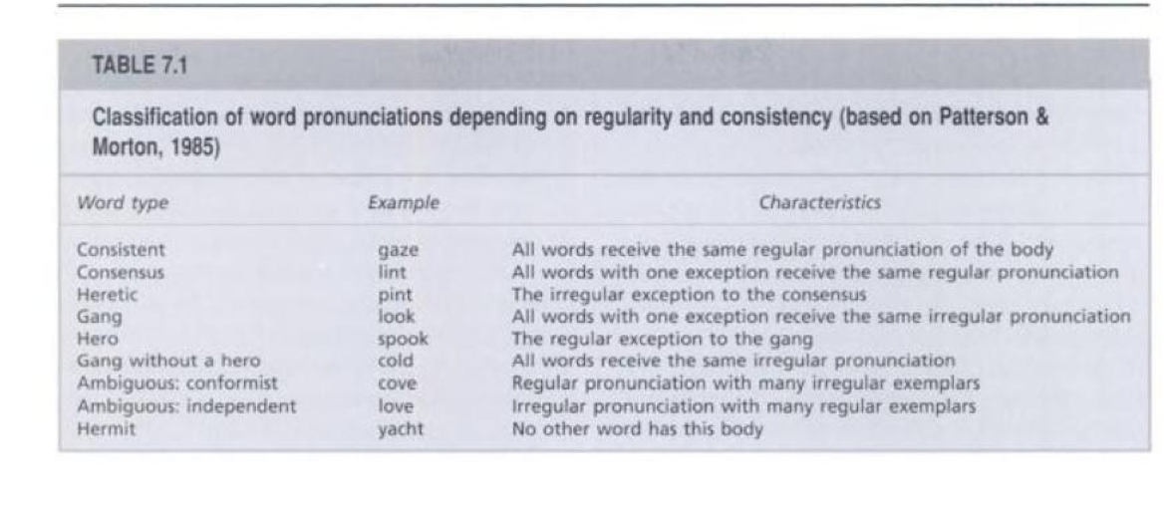
Normal Reading
Notes:
Classification table -
Regularity of the pronunciation with sound to spelling rules
Words share the same body – rime (final vowel and terminal consonants)

Slide 24
Normal Reading
Pronunciation Neighborhoods
Friends and enemies both influence the pronunciation time
Faster for large neighborhoods
Good readers do not show effects when neighborhood is controlled

Slide 25
Normal Reading
Phonological Mediation – sounds may have an influence on accessing a word’s meaning

Slide 26
Normal Reading
Phonological Mediation
Exp:
Category decision task – is this a fruit? Yes to pear, no to pour, make a lot of false positives to PAIR

Slide 27
Normal Reading
Phonological Mediation
Also make lots of errors in LDT when there are homophones, seems to be confusing feedback from lexical and phonology routes

Slide 28
Normal Reading
So phonological mediation?
“Weak phonological view” or that it comes from the indirect route to semantics (GPC)
“Strong phonological view” is phonological mediation – get meaning from sound and can’t recognize words without sound (inner speech coming up next!)

Slide 29
Normal Reading
Phonological Mediation support
People gaze longer at sole and soul even though the spelling makes it non ambiguous (sound is ambiguous)
Maybe only poor readers have to do this
May only occur for low frequency homophones

Slide 30
Normal Reading
May be that when you are “racing” the lexical route, in some circumstances it’s slow, so the GPC has time to assemble the sound, which requires you to make a decision.

Slide 31
Normal Reading
Silent reading and inner speech
Activate phonological code during silent reading
Tongue twisters take longer to read
If it was purely meaning based, this result wouldn’t happen

Slide 32
Normal Reading
Silent reading and inner speech
Inner speech seems to help comprehension
Puts information into working memory

Slide 33
Normal Reading
What about the times that you have to know the meaning to create the sounds? (row, bow, tear)
I tied my shoelaces in a bow.
I took a bow when I finished my performance.

Slide 34
Normal Reading
Speed reading?
These courses do not work.
When you increase your reading speed above the normal rate, comprehension declines

Slide 35
Normal Reading
Speed reading?
Just and Carpenter exp
Gave people easy text and difficult text to read
Normal readers did better on both
Speed readers got the same gist of the information, but were terrible at the details

Slide 36
Normal Reading
Speed reading is essentially skimming, but for comprehension you need information to stay on the fovea for a period of time.

Slide 37
Normal Reading
Problems with the simple dual route model
Lexical effects of reading nonwords, which should be read by the GPC side
Effects of regularity on pronunciation – which should be read by the lexical side

Slide 38
Acquired Dyslexia
Types of disorders
Acquired disorders – disorder caused by brain damage is acquired if it changes an ability that was previous intact
Developmental disorders – a disorder where the normal development or acquisition of a process is affected
Dyslexia – disorder of reading
Dysgraphias – disorders of writing

Slide 39
Acquired Dyslexia
Types of dyslexia
Central – involve high level processes
Peripheral – involve lower level processes

Slide 40
Acquired Dyslexia
Surface dyslexia - dyslexia where the person has trouble with exception words / irregular words
Over regularization errors – tend to pronounce irregular words with regular sound to spelling rules
Most people interpret this as a break down of the GPC non lexical route

Slide 41
Acquired Dyslexia
Surface dyslexia types
Type 1 – highly accurate at reading regular and pseudowords
Type 2 – some impairment of reading regular and pseudowords
Notes:
Type 2 influenced by lexical variables – so lexical route partially in tact, and GPC partially in tact

Slide 42
Acquired Dyslexia
Phonological dyslexia – a type of dyslexia where people can read words quite well but are poor at reading nonwords

Slide 43
Acquired Dyslexia
Phonological dyslexia
Problem with the GPC route, can’t read NW because there’s no way to sound them out
Read irregular words fine through the lexical route

Slide 44
Acquired Dyslexia
Phonological dyslexia problems
People are better if they are pseudohomophones (nite for night)
Have trouble with words that require inflections
Derivational errors – read a grammatical relative of the target
Visual errors – read as another word that orthographically the same (perform, perfume)

Slide 45
Acquired Dyslexia
Phonological dyslexia types
Some seem to be vision based – have trouble with complex phonemes (au) versus one to one mapping (iko)
Some seem to be sound based – can read pseudohomophones but not NW

Slide 46
Acquired Dyslexia
GPC three stage model
Graphemic analysis – parses letter strings into graphemes
Print to sound conversion – assigns phonemes to graphemes
Phonemic blending stage – sounds are assembled into phonological representation

Slide 47
Acquired Dyslexia
Deep dyslexia – disorder of reading characterized by semantic reading errors
Shows the same signs as phonological dyslexia
Semantic paralexias – reading error based on a word’s meaning
When people produce a word related to the meaning of the word shown (daughter – sister, pray-chapel)

Slide 48
Acquired Dyslexia
Deep dyslexia symptoms
Semantic errors
Visual errors
Substitute incorrect function words
Derivational errors
Can’t pronounce NWs

Slide 49
Acquired Dyslexia
Deep dyslexia symptoms
Image ability effect – if it’s easier to form a mental image of a word, it’s easier to read
Nouns are easier than adjectives
Adjectives are easier than verbs
Function words are harder than content words

Slide 50
Acquired Dyslexia
Deep dyslexia symptoms
Writing is impaired
Auditory STM is impaired
Reading ability depends on the context of the word
Patients vary on which symptoms they have, which indicates that there may not be a single underlying cause

Slide 51
Acquired Dyslexia
Deep dyslexia types
Input – have trouble finding the exact semantic representations of words when reading
Central – severe auditory comprehension deficit with reading trouble
Output – can get the semantic representation, but have trouble with phonological output

Slide 52
Acquired Dyslexia
Right Hemisphere hypothesis
The more of the left hemisphere that is damaged the more severe the deep dyslexia
Therefore the brain plasticity picks up in the right hemisphere, but it’s just not that good at the language thing

Slide 53
Models of Naming
Revised dual route model – added a third route to the model to account for acquired dyslexia information
228

Slide 54
Models of Naming
Routes
Non lexical route for putting together pronunciations from GPC
Standard GPC (spelling to sound rules)
Body subsystem – uses information about orthographic and phonological rimes
Direct route now: semantic direct route
Nonsemantic direct route
Notes:
Fits with data:
Lexical effects on NW and regularity effects on words are the interaction between lexical and non-lexical routes
Interference during retrieval of information
Conflict at resolving multiple phonological forms
Surface dyslexia is the loss of the ability to get to the orthographic lexicon
Phonological dyslexia loss of the indirect route
Deep dyslexia is still a mess

Slide 55
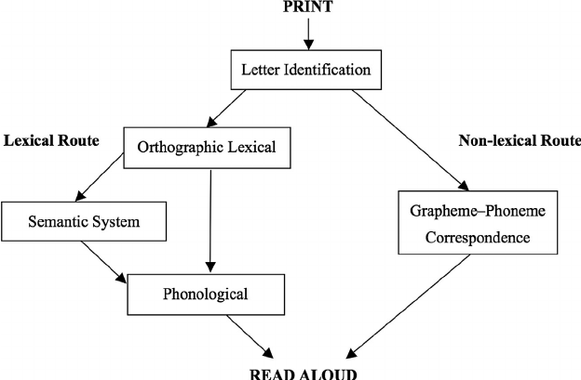
Dual Route Model

Slide 56
Models of Naming
The Analogy Model - single route model with an explicit pronunciation mechanism

Slide 57
Models of Naming
The Analogy Model
Pronunciation – occurs by making an analogy with other similar words
When a word is activated, it activates it’s neighbors
When the neighborhood is all normal (or rhymes) pronunciation is fast
When the neighborhood is a mix of regular and irregular versions, pronunciation slows and sometimes errors occur.

Slide 58
Models of Naming
The Analogy Model
Problems
Not clear how information is segmented
Makes incorrect predictions about how words are pronounced

Slide 59
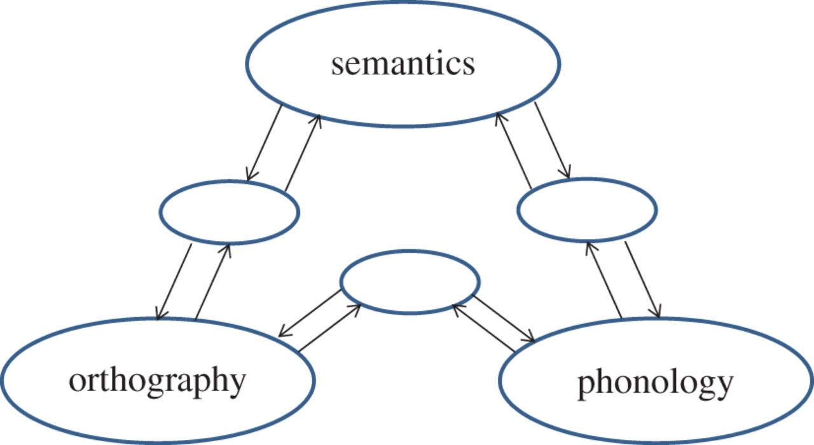
Models of Naming
Connectionist Model
Seidenberg and McClelland (1989) model (page 230 picture) – triangle model

Slide 60
Models of Naming
Connectionist Model
Similar to the interactive activation model
Reading and speech involve three pieces of information: orthographic, meaning and phonological
These pieces of information are all connected to each other with feedback connections

Slide 61
Models of Naming
Connectionist Model
Back-propagation - algorithm for learning input output pairs in connectionist networks
Wickelfeatures - phonemes represented by activation distribution over units

Slide 62
Models of Naming
Connectionist Model Testing
Model was “trained”
Activated orthographical units -> feeds to phonological units
At the frequency of real life

Slide 63
Models of Naming
Connectionist Model Testing
After the training > the model tested out pretty well
Phonological error scores – naming task
Orthographic error scores – LDT task
These task times mirror real people

Slide 64
Models of Naming
Revised PMSP model
The original model did badly because of the Wickelfeatures
For example, it didn’t want to make a connection between GAVE and SAVE
Activations didn’t match
PSMP = Plaut, Seidenberg, Patterson & McClelland

Slide 65
Models of Naming
Revised PMSP
Trained with more realistic phonological restraints
Orthographic units were constrained to letters that occur together in language

Slide 66
Models of Naming
Revised PMSP
Semantics – model has new semantic connections
Orthography to semantics directly
Orthography to phonology to semantics

Slide 67
Models of Naming
So do the connectionist models explain dyslexia as well as the dual route model?

Slide 68
Models of Naming
Surface dyslexia – cut out hidden units in PMSP model
Reset weights to zero (wiping out learning)
Some reset themselves back (shows why there are various types of dyslexia)

Slide 69
Models of Naming
Phonological dyslexia – damage the phoneme representations
Phonological impairment hypothesis – have overall trouble with phonemes

Slide 70
Models of Naming
Deep dyslexia – trained to associate pronunciations with meanings of words
Sememes - semantic representations are patterns of activation across the network
Cleanup units – representations that are complex relationships between features, creates a “semantic space”

Slide 71
Models of Naming
Deep dyslexia
Attractors – a point in the connectionist network to which related states are attracted
Paralexias occur because the same pattern of activation is seen but the wrong word gets activated or wins activation because of the lesions (i.e. the clusters are close, overlap a lot, and you just choose the wrong one)

